Slide 1
Data Science Hackathon Ecommerce Product Categorization Build and train a multi-class text classifier model using the provided dataset. This model should accurately categorize eCommerce products based on their descriptions

Slide 2
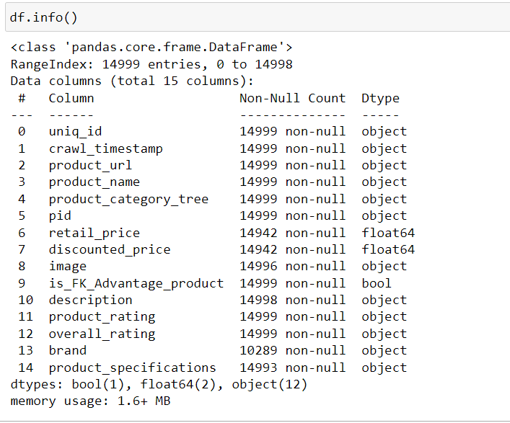
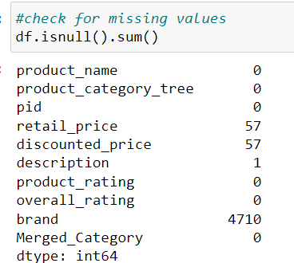
Data Analysis
The dataset has some missing values in features like brand and retail_price which been handled accordingly.
The dataset contains 14999 entries with total 15 columns namely product_name, product_category_tree, description and so on.

Slide 3
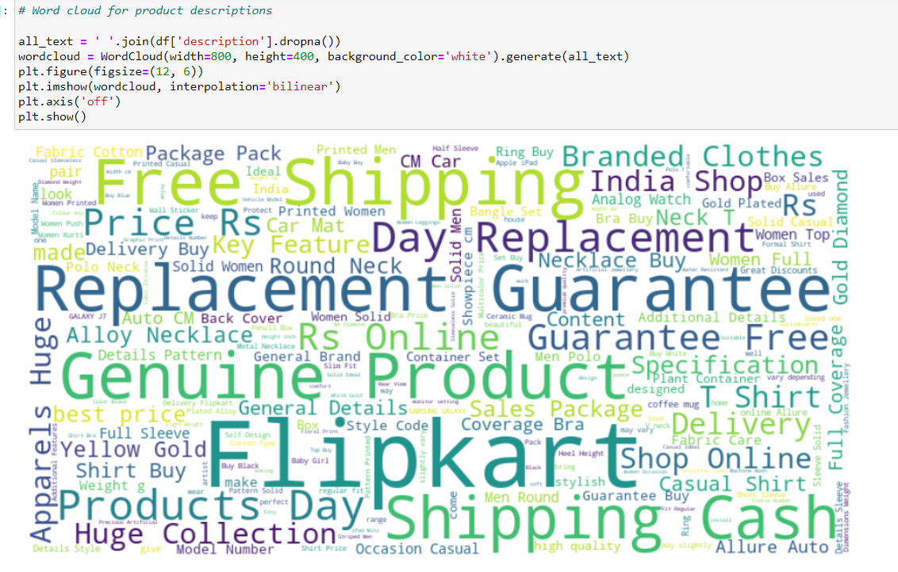
Data Visualization
Wordcloud for words in the description highlighting the frequent terms used in the product description

Slide 4
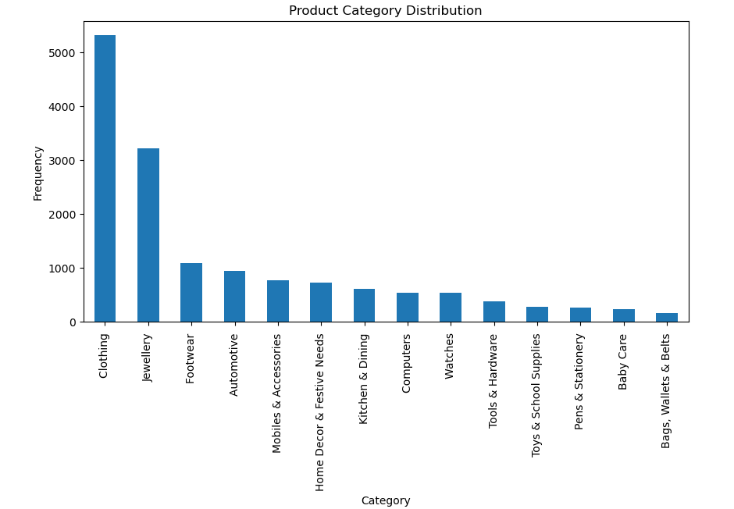
Data Visualization
This barchart depicts the distribution of products across the different categories. We can see that Clothing and jewellery has the most product assortment.

Slide 5
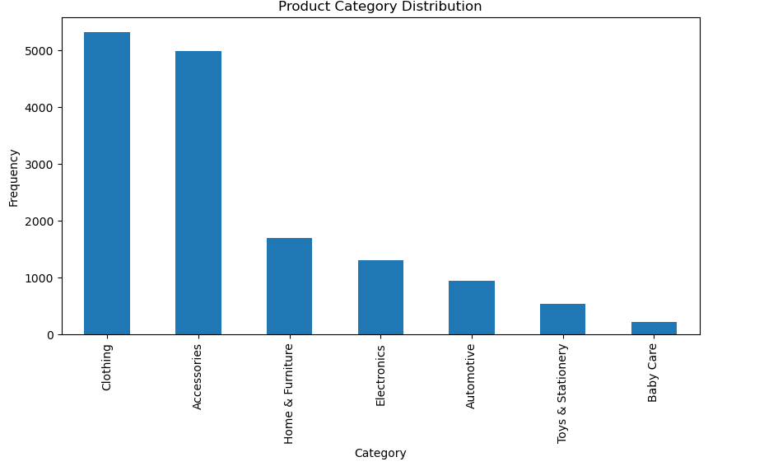
Data Visualization
Due the class imbalance in the category feature, sub-categories under the same main categories have been merged.

Slide 6
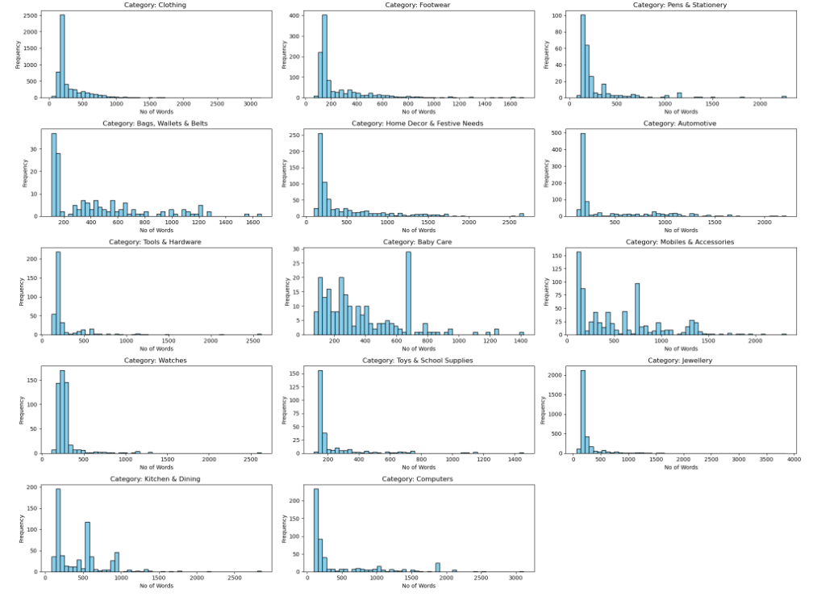
Data Visualization
Histogram for the no of words in description for each product category to show a clear visualization of how the description lengths vary across different product categories.
Maximum no of words are for the category –Clothing and minimum is for baby care category

Slide 7
Text Preprocessing and Feature Engineering
Text cleaning involved removing HTML tags, punctuation, and stopwords.
stemming: processing of reducing words by findig the root part of a word
Pos Tagging : Part-of-speech (POS) tagging is the process of assigning a part of speech to each word in a sentence
CountVectorizer : converts a collection of text documents into a matrix of token counts
TFIDF : Extracted the tfidf representation matrix of the text data.

Slide 8
Model Building
After performing the train test split on the dataset, have designed and trained 5 models:
Logistic Regression
SVC
Random Forest Classifier
Naïve Bayes Classifier
Gradient Boosting Classifier
Base on the highest accuracy score, selected the best model SVC with the highest accuracy of 98.7% and performed hyper parameter tuning using GridSearchCV.

Slide 9
Data Prediction
Results:
The final model selected SVC with best parameters found with GridSearch CV had the accuracy rate of 99.3%.
We can almost accurately predict the product category based on the description there by reducing the errors with manual processing.
Challenges:
Handling class imbalance was crucial to ensure the model did not favor majority classes.
Selecting the best models for classification.
Observations:
Based on the visualization we can understand that product descriptions across products have a lot of keywords that consumers look for while shopping.
Observed that there are categories like clothing have longer descriptions and categories like baby care have very short descriptions.
Final model trained
had the accuracy of
99.3%

